Slide 1
Christendom and the Crusades
Holy Warfare

Slide 2
Learning Objective
To explore how battles were fought during the Crusades.
Success Criteria
To examine the differences between Christian and Muslim warriors.
To compare the strengths and weaknesses of each force.
To analyse written sources from the Crusades.

Slide 3

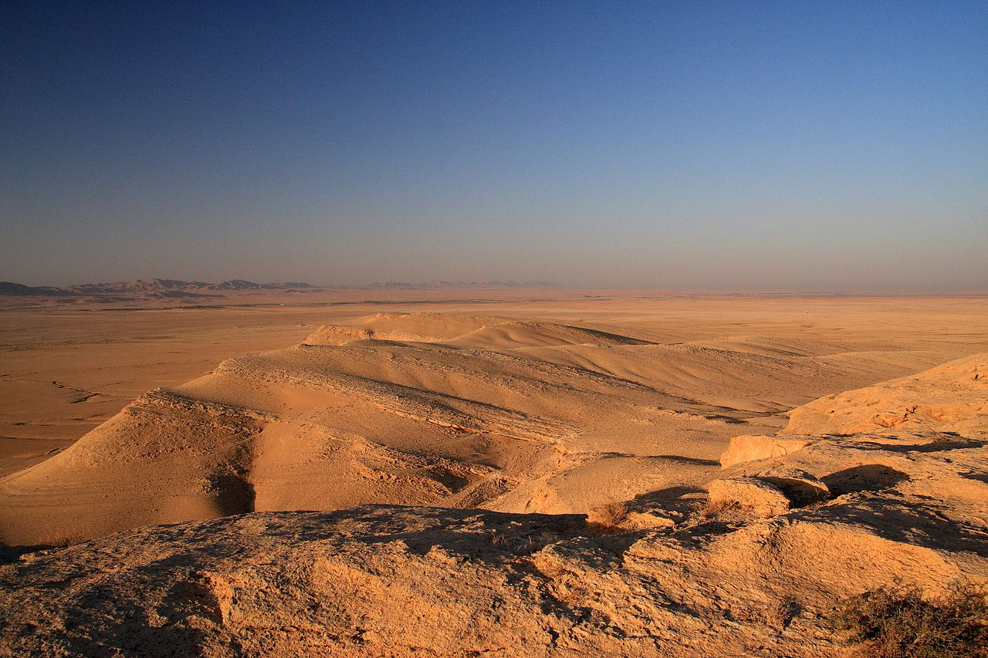
I See, I Hear, I Feel
A stretch of desert landscape in Syria, a common place for Crusaders to fight.
Imagine you are the person taking this photograph. What can you see, hear and what do you feel about this landscape?

Slide 4

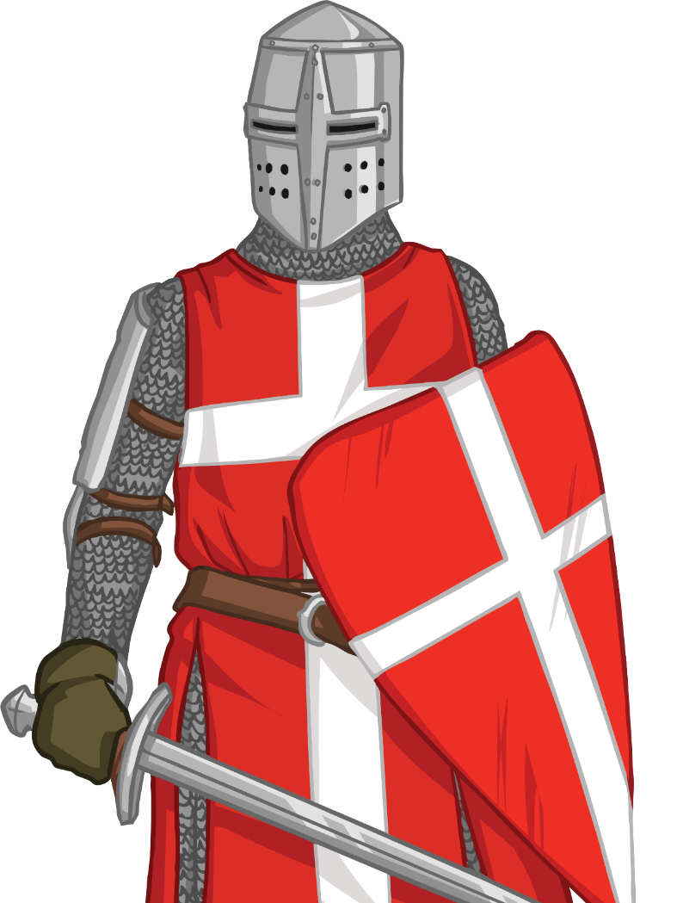
Crusader Knight
Knights from all over Europe came to fight in the Crusades. Some religious groups of knights were formed too; groups such as the Knights Hospitaller and the Knights Templar.
Use your activity sheet to match the
equipment to your picture of a knight.
When you have done this, write down two disadvantages and two advantages that a person wearing this equipment may face when fighting in a desert landscape like the one we saw on the last slide.

Slide 5
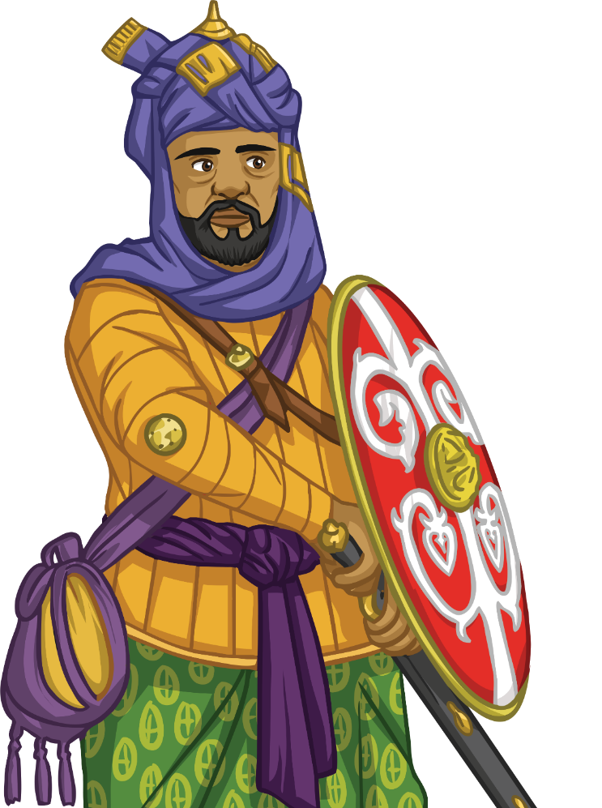
Muslim Warrior
There was a great variety of troops on the Muslim side of the Crusades, from desert nomads to elite Egyptian cataphracts (armoured horsemen). Often the first Muslim troops a crusading army would meet would be Tatars from Turkey.
Use your activity sheet to match the equipment
to your picture of a Muslim warrior.
When you have done this, write down two advantages and two advantages that a person wearing this equipment may face when fighting in a desert landscape like the one we saw on the I See, I Hear, I Feel slide.

Slide 6
Letters from the Front Lines
We have many letters from Christian Crusaders that were written during the Crusades. On your activity sheet there are some examples.
Read these sources and analyse them by answering the questions on your activity sheet.
“After we had for some days besieged the city with many machines and various engines of war, the craft of the Turks, as often before, deceived us greatly. For on the very day on which they had promised that they would surrender, Soliman and all the Turks, collected from neighbouring and distant regions, suddenly fell upon us and attempted to capture our camp. However the count of St. Gilles… made an attack upon them and killed an innumerable multitude.”
Letter from Anselme of Ribemont to the Archbishop of Reims, 1098

Slide 7

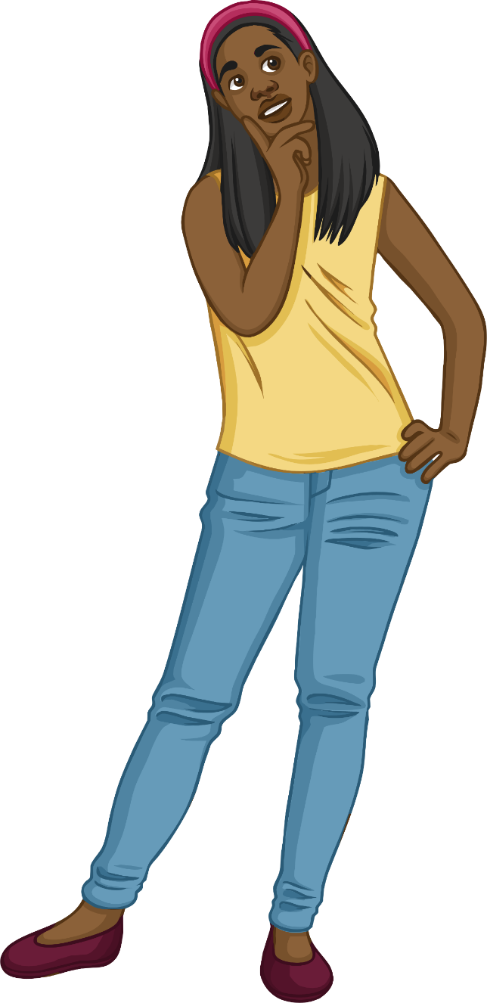
Feedback
Now that we have analysed the sources, what do we know about the way battles were fought during the Crusades?

Slide 8


Who Should Win?
With a partner, take on the role of a Muslim warrior and a Christian knight.
Discuss the following points with each other from the point of view of your character:
Why are you fighting?
What weapons and armour do you have?
What are the main advantages for your side?
What are the main disadvantages for your side?
Following your discussion, try to come to a decision as to which side has the upper hand. Be prepared to share your conclusions with the class.

Slide 9

Pigeon Post from the Front Lines
Imagine that you are a Crusader knight, going into battle in the area of Syria shown here. Write a quick message explaining your situation and emotions. If you’re lucky, a pigeon may carry it back to your family in England. You can only use 140 characters, as time is short!

Slide 10
Photo courtesy of (@flickr.com) - granted under creative commons licence - attribution

